Slide 1
Introduction to Plant Physiology
13th October 2025

Slide 2
Plant Physiology
What is Plant Physiology?
Plant physiology is the branch of botany that deals with the functioning, processes, and activities of plants.
Physiology Ttherefore is the study of the physical and biochemical functions of living organisms.
Plant Physiology specifically focuses on the mechanisms and processes by which plants operate, grow, and interact with the environment.

Slide 3
Scope of Plant Physiology:
Explores how plants grow, develop, and survive
Studies processes like photosynthesis, respiration, transpiration, nutrient uptake, and hormonal regulation
Links between structure (anatomy) and function (physiology)

Slide 4
Importance of Plant Physiology:
Area | Relevance
🌾 Agriculture | Helps improve crop yield, disease resistance, and stress tolerance
🌍 Environmental Science | Understanding how plants respond to climate change and pollutants
🧪 Biotechnology | Genetic engineering for better growth, resistance, and nutritional quality
💧 Water Management | Knowledge of transpiration and water use efficiency
🍃 Photosynthesis Research | Basis for bioenergy and climate mitigation strategies

Slide 6
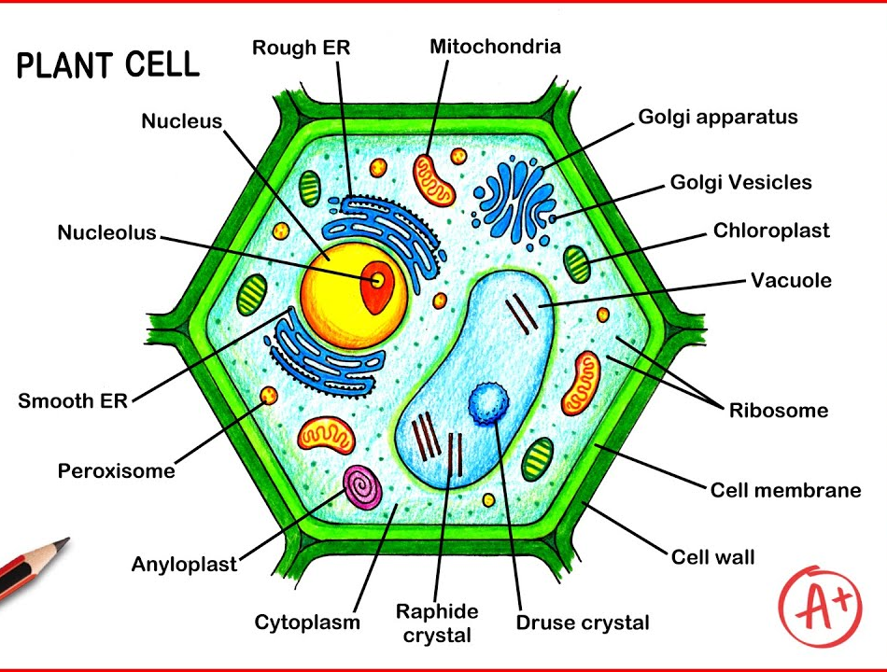

Slide 7
The Plant Cell Structure
Organelle / Structure | Function
Nucleus | Controls cell activities; contains DNA (genetic material)
Nucleolus | Found inside the nucleus; produces ribosomes
Rough Endoplasmic Reticulum (Rough ER) | Synthesizes proteins (has ribosomes on its surface)
Smooth Endoplasmic Reticulum (Smooth ER) | Synthesizes lipids and detoxifies harmful substances
Mitochondria | Produces energy (ATP) through cellular respiration
Golgi Apparatus | Modifies, packages, and distributes proteins and lipids
Golgi Vesicles | Transport materials from the Golgi to other parts of the cell
Chloroplast | Site of photosynthesis; converts light energy into chemical energy (glucose)
Vacuole | Stores water, nutrients, and waste; maintains turgor pressure
Druse Crystal | Star-shaped crystals of calcium oxalate; also defensive

Slide 8
Ribosome
Synthesizes proteins (free-floating or attached to ER)
Cell Membrane
Semi-permeable membrane; controls movement of substances in and out of cell
Cell Wall
Made of cellulose; provides structure, support, and protection
Peroxisome
Breaks down fatty acids and detoxifies hydrogen peroxide (H₂O₂)
Amyloplast
Stores starch (a carbohydrate reserve)
Cytoplasm
Gel-like fluid where organelles are suspended; site of metabolic reactions
Raphide Crystal
Needle-shaped crystals of calcium oxalate; may deter herbivory

Slide 9
Basic Cell Types in Plants
Cell Type | Function
Parenchyma | Photosynthesis, storage, healing
Collenchyma | Flexible support in young organs
Sclerenchyma | Rigid support (dead cells, thick walls)
Xylem cells | Water conduction (tracheids and vessels)
Phloem cells | Food transport (sieve tubes and companion cells)

Slide 10
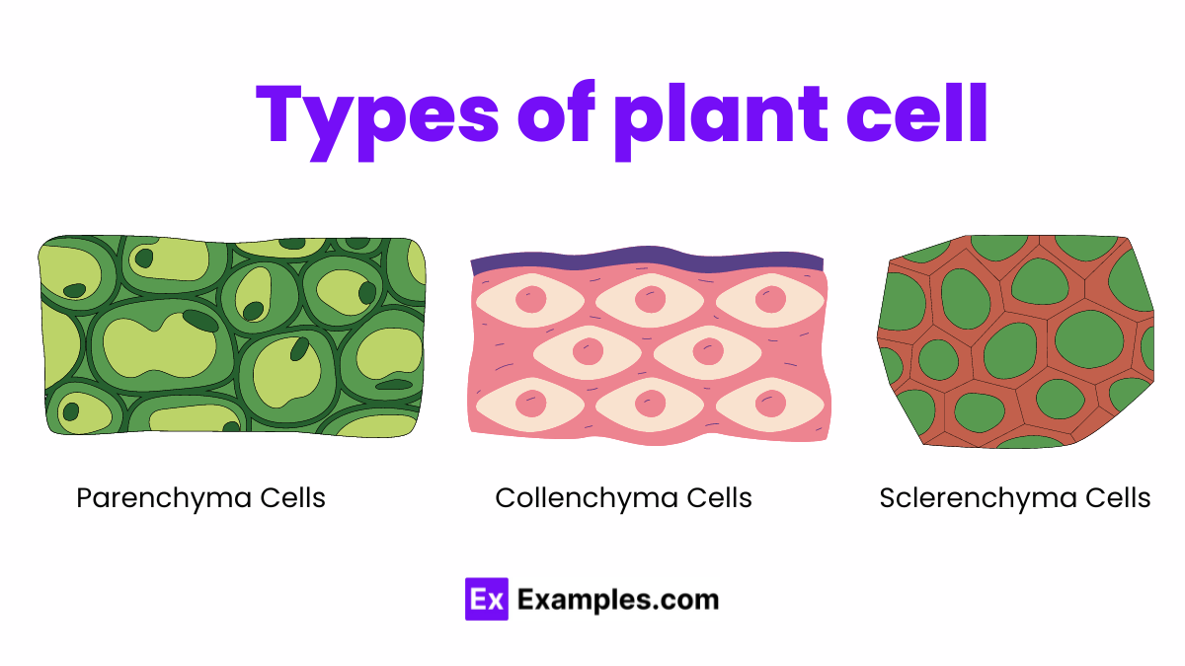

Slide 11
Morphogenesis
Definition:
Morphogenesis refers to the biological process that causes an organism or organ to develop its shape and structure.
➤ In Plants:
Controlled by genes, hormones, and environmental signals
Involves cell division, expansion, and differentiation
Influences organ formation – roots, leaves, stems, flowers

Slide 12
➤ Key Regulators:
Plant hormones: Auxins, cytokinins, gibberellins, ethylene, and abscisic acid
Gene expression: Developmental genes guide organ formation
Environmental cues: Light, gravity, water, nutrients

Slide 13
Seed Structure
A seed is a mature ovule containing an embryo, a food reserve, and a protective seed coat.

Slide 14
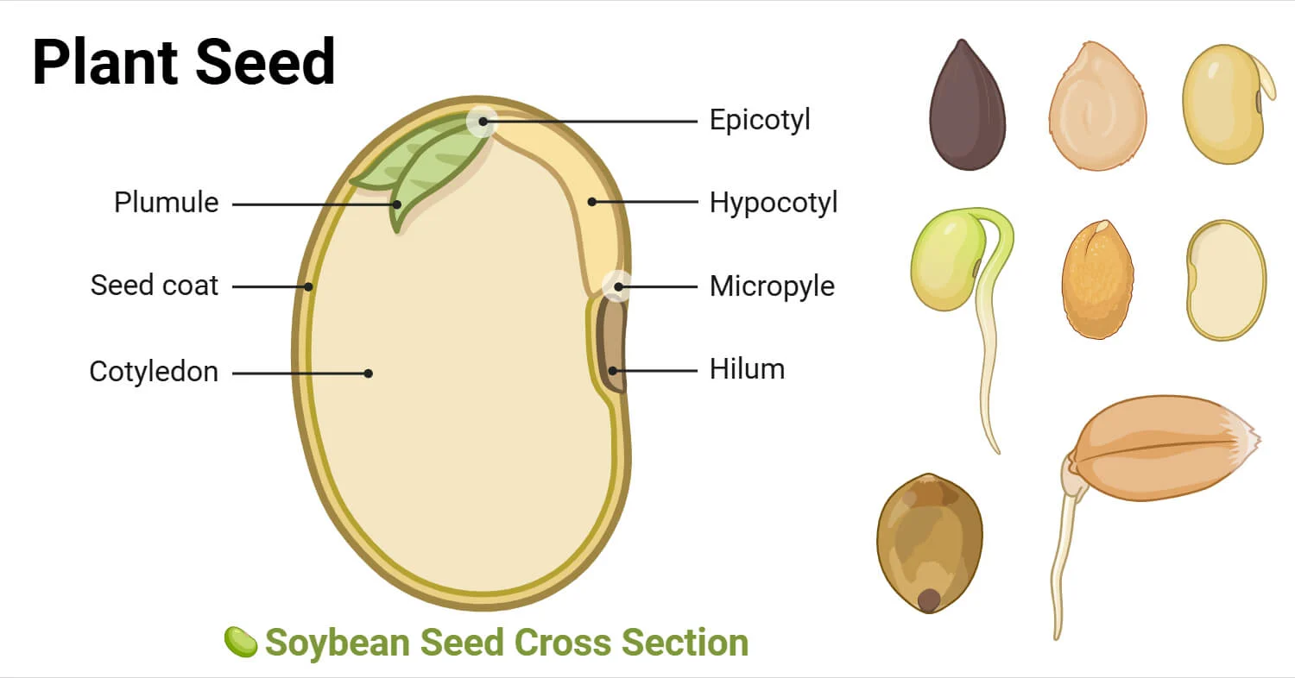

Slide 15
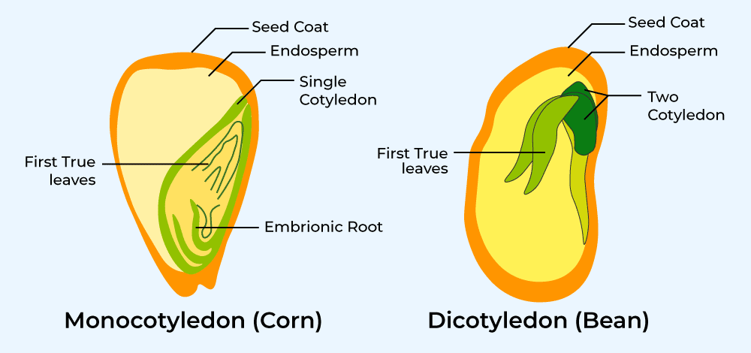
Main Parts of a Seed:

Slide 16
Part | Function
Seed coat (Testa) | Protective outer covering of the seed
Embryo | Young plant consisting of: - Radicle (embryonic root) - Plumule (embryonic shoot) - Cotyledons (seed leaves that store or absorb food)
Endosperm | Nutrient-rich tissue that provides food for the developing embryo (in monocots)
Hilum | Scar where seed was attached to the fruit or ovary
Micropyle | Small pore for water entry during germination

